Slide 1

MACHINE LEARNING-BASED EARLY DETECTION OF TEMPORAL ANOMALIES IN B2B PROCUREMENT USING CUSTOMER–PART PURCHASE PATTERNS
PRESENTED BY :
PRESENTED TO :
(Group BE-A21)
Jaydip Chavan
Kaushal Borude
Anuj Khaire
Devanshu Nirmal
Rahul Diwate Sir
MID-SEMESTER FIRST REVIEW

Slide 2
PROBLEM
1.
2.
CUSTOMERS MAY REORDER THE SAME PART AT DIFFERENT TIME INTERVALS.
REORDER TIMING VARIES ACROSS CUSTOMER–PART COMBINATIONS.
3.
4.
A FIXED INTERVAL CANNOT REPRESENT EVERY PURCHASING PATTERN.
THE PROJECT FOCUSES ON UNUSUALLY SHORT REORDER INTERVALS RELATIVE TO HISTORICAL BEHAVIOUR.

Slide 3
AIM
TO DEVELOP A TEMPORAL ANOMALY DETECTION APPROACH FOR IDENTIFYING UNUSUALLY EARLY REORDER EVENTS IN CUSTOMER–PART TRANSACTION HISTORIES USING INTER-PURCHASE INTERVALS.
OBJECTIVES
  PREPROCESS DATA AND ORGANIZE PURCHASE RECORDS CHRONOLOGICALLY PER CUSTOMER–PART COMBINATION.
  CALCULATE INTER-PURCHASE INTERVALS (IPI) FROM CONSECUTIVE PURCHASE RECORDS.
  ANALYSE HISTORICAL AND RECENT INTERVALS TO IDENTIFY UNUSUALLY EARLY EVENTS.
  DEVELOP AN ANOMALY SCORING APPROACH BASED ON DEVIATION FROM HISTORICAL BEHAVIOUR.
  EVALUATE THE PROPOSED APPROACH USING HISTORICAL DATA AND SYNTHETIC CASES.

Slide 4
EXPECTED OUTCOME
01
02
03
04
Customer–Part
Temporal Histories
Inter-Purchase
Interval Analysis
Potentially Early
Reorder Detection
Anomaly Scoring
and Ranking
Evaluation will determine the final feature configuration and anomaly threshold.

Slide 5

NATIONAL AND INTERNATIONAL CURRENT STATUS
India
■
Procurement and supply-chain digitization is increasing the availability of transaction data.
■
GeM has incorporated AI/ML capabilities for procurement-related pattern analysis.
■
Indian research has examined AI and big-data analytics in manufacturing and supply-chain environments.
International
■
Research covers AI/ML applications in procurement and purchasing.
■
Studies address forecasting, anomaly detection, supplier risk, and customer behaviour.
■
Procurement decision-support continues to be an active research area.

Slide 6
NOVELTY
THE PROJECT FOCUSES ON CUSTOMER–PART-LEVEL EARLY REORDER DETECTION BY ANALYSING INTER-PURCHASE INTERVALS, HISTORICAL AND RECENT PURCHASING BEHAVIOUR, AND TEMPORAL FEATURES TO IDENTIFY POTENTIALLY EARLY REORDER EVENTS RELATIVE TO THE SPECIFIC CUSTOMER–PART HISTORY.

Slide 7
LITERATURE REVIEW — RESEARCH LANDSCAPE
Demand Forecasting
Procurement Analytics
Procurement Anomaly
Detection
Supply-Chain Risk /
Early Warning
Customer Purchase
Behaviour
Next-Purchase /
Churn Prediction
25
RESEARCH PAPERS
REVIEWED

Slide 8
RESEARCH GAP
EXISTING RESEARCH
1.
DEMAND FORECASTING
2.
PROCUREMENT ANALYTICS
3.
PROCUREMENT ANOMALY DETECTION
4.
SUPPLY-CHAIN RISK
5.
CUSTOMER BEHAVIOUR
OBSERVED GAP
LIMITED DIRECT FOCUS IN THE REVIEWED LITERATURE ON UNUSUALLY EARLY REORDER DETECTION USING CUSTOMER–PART-SPECIFIC INTER-PURCHASE INTERVAL HISTORIES.

Slide 9
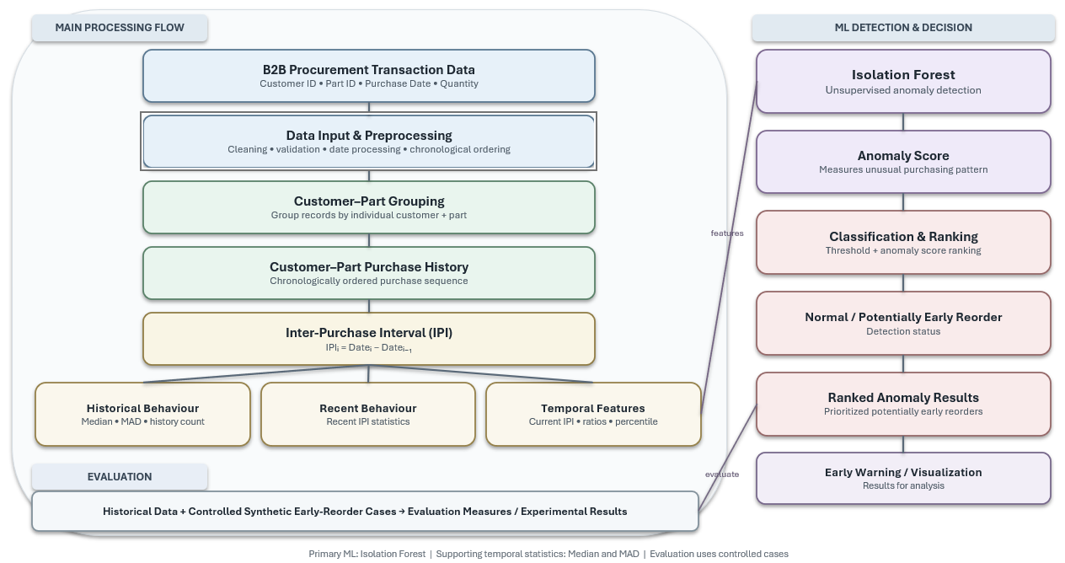
COMPLETE SYSTEM ARCHITECTURE

Slide 10
ALGORITHM USED
ISOLATION FOREST
1.
2.
UNSUPERVISED: DOES NOT REQUIRE A LARGE SET OF LABELLED ANOMALY EXAMPLES.
ANOMALY DETECTION: SUITABLE FOR IDENTIFYING UNUSUAL REORDER EVENTS FROM TEMPORAL FEATURES.
3.
4.
ANOMALY SCORING: PROVIDES ANOMALY SCORES THAT CAN BE USED TO RANK POTENTIALLY EARLY REORDER EVENTS.
SUITABLE FOR ENGINEERED FEATURES: CAN OPERATE ON TEMPORAL FEATURES SUCH AS IPI, MEDIAN, MAD, AND OTHER DERIVED FEATURES.

Slide 11
CONCLUSION
THE PROJECT FOCUSES ON POTENTIALLY EARLY REORDER DETECTION IN B2B PROCUREMENT TRANSACTION DATA.
1.
INTER-PURCHASE INTERVALS PROVIDE THE PRIMARY TEMPORAL REPRESENTATION OF CUSTOMER–PART PURCHASING BEHAVIOUR.
2.
ISOLATION FOREST IS SELECTED AS THE PRIMARY UNSUPERVISED ML ALGORITHM USING ENGINEERED TEMPORAL FEATURES.
3.
PRELIMINARY IMPLEMENTATION IS COMPLETE FOR PREPROCESSING, CUSTOMER–PART GROUPING, IPI ANALYSIS AND CONTROLLED EARLY-REORDER EXPERIMENTS.
4.

Slide 12
SDG MAPPING
SDG 9 — INDUSTRY, INNOVATION AND INFRASTRUCTURE
MACHINE LEARNING & DATA-DRIVEN ANALYTICS
THE PROJECT APPLIES MACHINE LEARNING TO B2B PROCUREMENT BY ANALYSING CUSTOMER–PART PURCHASE HISTORIES AND INTER-PURCHASE INTERVALS TO IDENTIFY POTENTIALLY EARLY REORDER EVENTS.
CONTRIBUTION:
SUPPORTS DIGITAL TRANSFORMATION AND DATA-DRIVEN DECISION-MAKING IN PROCUREMENT.
SDG 12 — RESPONSIBLE CONSUMPTION AND PRODUCTION
INFORMED PROCUREMENT & RESOURCE MANAGEMENT
THE PROJECT APPLIES MACHINE LEARNING TO B2B PROCUREMENT BY ANALYSING CUSTOMER–PART PURCHASE HISTORIES AND INTER-PURCHASE INTERVALS TO IDENTIFY POTENTIALLY EARLY REORDER EVENTS.
CONTRIBUTION:
SUPPORTS DIGITAL TRANSFORMATION AND DATA-DRIVEN DECISION-MAKING IN PROCUREMENT.

Slide 13
REFERENCES
[1] S. P. Kenaka et al., “Enhancing Intermittent Spare Part Demand Forecasting: A Novel Ensemble Approach with Focal Loss and SMOTE,” Logistics, 2025. doi: 10.3390/logistics9010025.
[2] R. L. Goldsmith and A.-L. Sachs, “Spare Part Demand Forecasting in Every Phase: A Data Pooling Approach to the Bass Life Cycle Model,” International Journal of Production Research, 2025. doi: 10.1080/00207543.2025.2607643.
[3] Z. Kunić et al., “Derived Feature Engineering and ABC–XYZ Segmentation for Machine Learning-Based Forecasting of Intermittent Spare Parts Demand,” Applied Sciences, 2026. doi: 10.3390/app16125804.
[4] S. Nathan et al., “A Machine Learning Framework for Long-Term Forecasting of Spare Part Demand in End-of-Life Product Scenarios,” Scientific Reports, 2026. doi: 10.1038/s41598-025-31171-2.
[5] B. S. Nathan et al., “Primacy of Feature Engineering Over Architectural Complexity for Intermittent Demand Forecasting,” Scientific Reports, 2026. doi: 10.1038/s41598-026-35197-y.
[6] M. Abbaszadeh Nakhost et al., “Full Automation or Just a Copilot? A Study of Large Language Models on Spare Parts Demand Forecasting with OpenAI o1-mini,” International Journal of Production Research, 2025. doi: 10.1080/00207543.2025.2591225.
[7] P. G. Giannopoulos et al., “Machine Learning Algorithms in Intermittent Demand Forecasting: A Review,” International Journal of Production Research, 2025. doi: 10.1080/00207543.2025.2578701.
[8] “An Integrated Analytics Model for Supplier Selection and Order Allocation with Machine Learning and Multi-Criteria Optimization,” Decision Analytics Journal, 2025. doi: 10.1016/j.dajour.2025.10059

Slide 14
[9] D. Balkan and G. A. Akyuz, “Artificial Intelligence (AI) and Machine Learning (ML) in Procurement and Purchasing Decision-Support (DS): A Taxonomic Literature Review and Research Opportunities,” Artificial Intelligence Review, 2025. doi: 10.1007/s10462-025-11336-1.
[10] E. Schneider dos Santos et al., “Detection of Fraud in Public Procurement Using Data-Driven Methods: A Systematic Mapping Study,” EPJ Data Science, 2025. doi: 10.1140/epjds/s13688-025-00569-3.
[11] A. Alaoua and M. Karim, “Intelligent Early Warning System for Supplier Delays Using Dynamic IoT-Calibrated Probabilistic Modeling in Smart Engineer-to-Order Supply Chains,” Applied System Innovation, 2025. doi: 10.3390/asi8050124.
[12] C. Xiaoyang, “Explainable Dual LSTM-Autoencoders with Exogenous Features for Anomaly Detection and Supply Chain Forecasting,” Scientific Reports, 2025. doi: 10.1038/s41598-025-26449-4.
[13] S. Roosta et al., “Predicting Customer Loyalty in Omnichannel Retailing Using Purchase Behavior, Socio-Cultural Factors, and Learning Techniques,” PLOS ONE, 2025. doi: 10.1371/journal.pone.0330338.
[14] A. Herreros-Martínez et al., “Applied Machine Learning to Anomaly Detection in Enterprise Purchase Processes: A Hybrid Approach Using Clustering and Isolation Forest,” Information, 2025. doi: 10.3390/info16030177.
[15] M. Ndolo et al., “A Hybrid Machine Learning Model for Detecting and Preventing Corruption in Kenya’s Public Procurement Contracts,” Machine Learning Research, 2025. doi: 10.11648/j.mlr.20251002.14.
[16] A. Wong et al., “A Data-Driven Approach to Customer Lifetime Value Prediction Using Probability and Machine Learning Models,” Decision Analytics Journal, 2025. doi: 10.1016/j.dajour.2025.100601.

Slide 15
[17] T. Stylianou and A. Pantelidou, “A Machine Learning Approach to Consumer Behavior in Supermarket Analytics,” Decision Analytics Journal, 2025. doi: 10.1016/j.dajour.2025.100600.
[18] Z. Wang, “The Application of Deep Learning in User Purchase Behaviour Analysis and Marketing Decision Support,” International Journal of Computational Intelligence Systems, 2025. doi: 10.1007/s44196-025-00954-w.
[19] Z. Lou et al., “Predicting Customer Buying Habits Using Convolutional Neural Network,” Journal of Big Data, 2026. doi: 10.1186/s40537-026-01464-y.
[20] L. Simon, “A Generalised Comparison of Pareto/NBD Based Forecasts Using MCMC, Maximum Likelihood, and Heuristics,” Journal of Business Economics, 2025. doi: 10.1007/s11573-025-01237-8.
[21] H. Xia et al., “Integrated Machine Learning Model for Managing Customer-Driven End-to-End Supply Chain Uncertainty,” International Journal of Production Research, 2026. doi: 10.1080/00207543.2026.2648764.
[22] M. Wyrembek et al., “Causal Machine Learning for Supply Chain Risk Prediction and Intervention Planning,” International Journal of Production Research, 2025. doi: 10.1080/00207543.2025.2458121.
[23] M. A. Khaled et al., “Machine Learning Approaches for Early Prediction of Supply-Chain Disruptions and Operational Risks,” Journal of Information Systems Engineering and Management, 2024. doi: 10.52783/jisem.v9i4s.14812.
[24] L. González-Flores et al., “The Relevance of Lead Prioritization: A B2B Lead Scoring Model Based on Machine Learning,” Frontiers in Artificial Intelligence, 2025. doi: 10.3389/frai.2025.1554325.

Slide 16
[25] D. O’Brien and R. E. Kunz, “Will They Stay or Will They Go? Application of Machine Learning Classifiers of Purchase and Churn Prediction to a Digital Journalistic Platform,” Journal of Media Business Studies, 2025. doi: 10.1080/16522354.2024.2444075.
[26] Government of India, Ministry of Commerce & Industry, “Government e-Marketplace: AI and Machine Learning Applications in Public Procurement,” Press Information Bureau, 2026.
[27] “Examining the Effect of AI-BDA on Manufacturing Firm Performance: An Indian Approach,” International Journal of Information Management Data Insights, 2025. doi: 10.1016/j.jjimei.2024.100306
[28] J. M. Spreitzenbarth et al., “Artificial Intelligence and Machine Learning in Purchasing and Supply Management: A Mixed-Methods Review of the State-of-the-Art in Literature and Practice,” Journal of Purchasing and Supply Management, 2024. doi: 10.1016/j.pursup.2024.100896

Slide 17
THANK YOU
THANK YOU

